Slide 1
InfraHack – Depth Challenge
How deep is this water main buried?...

Slide 2

55,000 Litres
Per Year
Notes:
Let me start by asking how many people have turned on a tap today, maybe taken a shower or even flushed the toilet? (Pause) I think it’s fair to say everyone in the room.
The average person in the UK uses 150 litres of water a day which adds up to about 55,000 litres a year…………that’s about a swimming pools worth of water for every 7 people per year………and I think we all just take it for granted that we have unlimited access to clean water but we rarely consider how these services are delivered

Slide 3
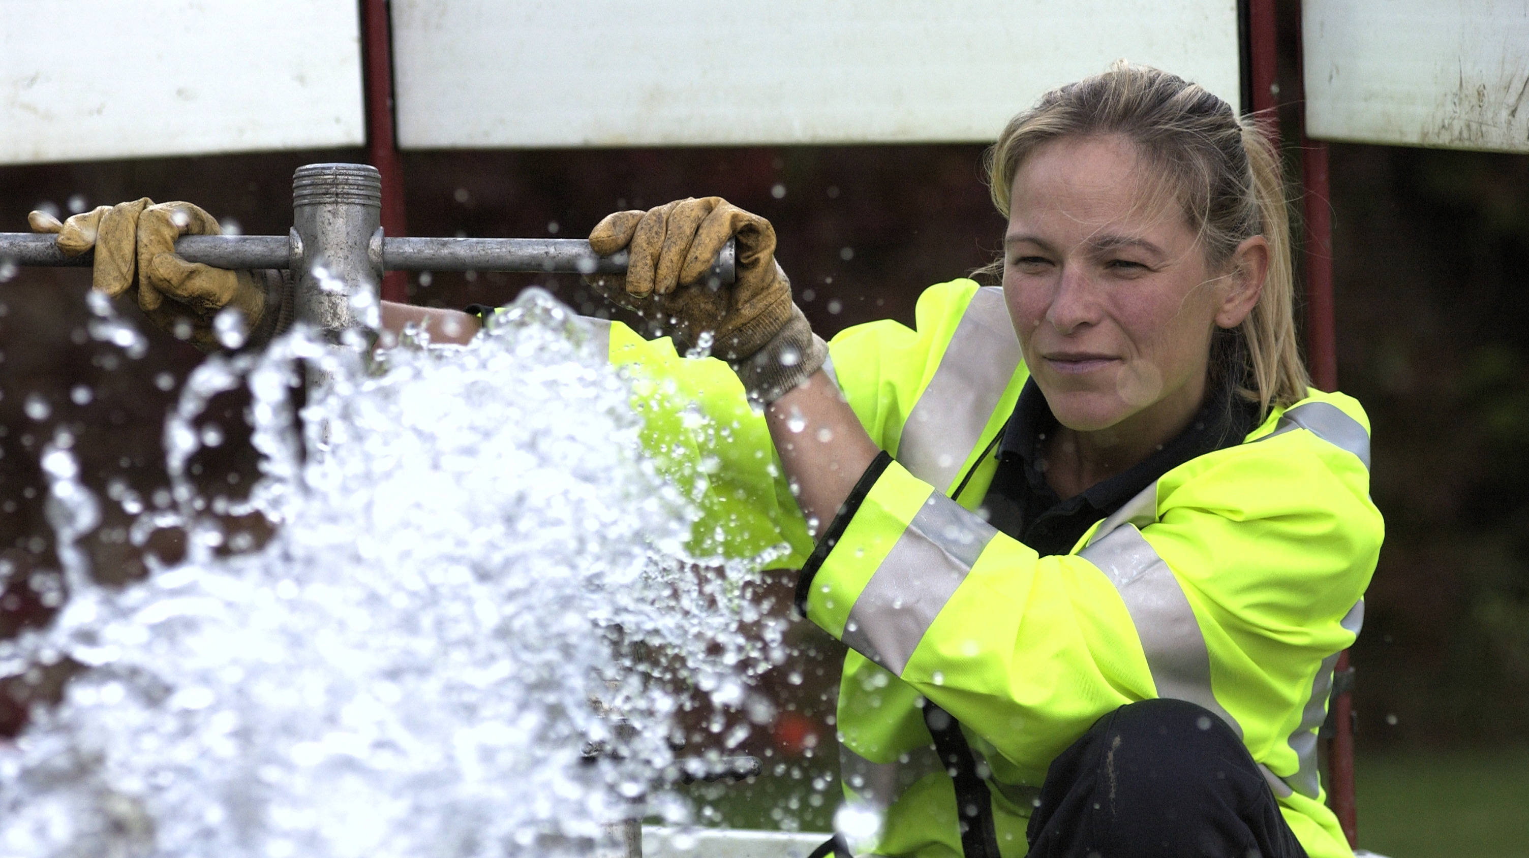
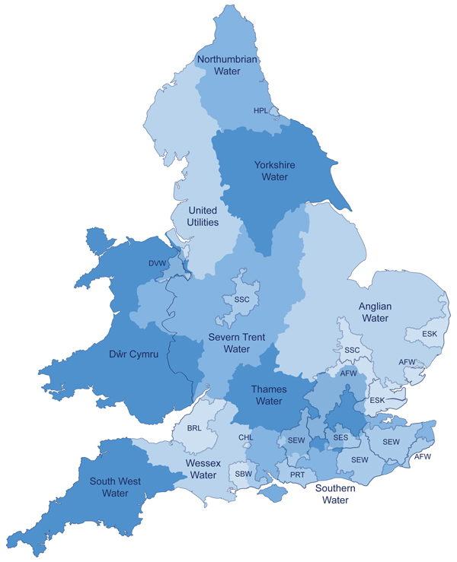
Northumbrian Water
Water & Sewerage services
2.8M customers
1.3M properties
Essex & Suffolk Water
1.6M customers
794K properties
Water only services
Essex & Suffolk Water
1.6M customers
794K properties
Water only services
Delivering Unrivalled Service for Customers
Notes:
Everyday, Northumbrian Water, which employs over 3000 people, provides 1.1 billion litres of water and sewerage services to 4.4. million people across the north of England, Essex and Suffolk.

Slide 4
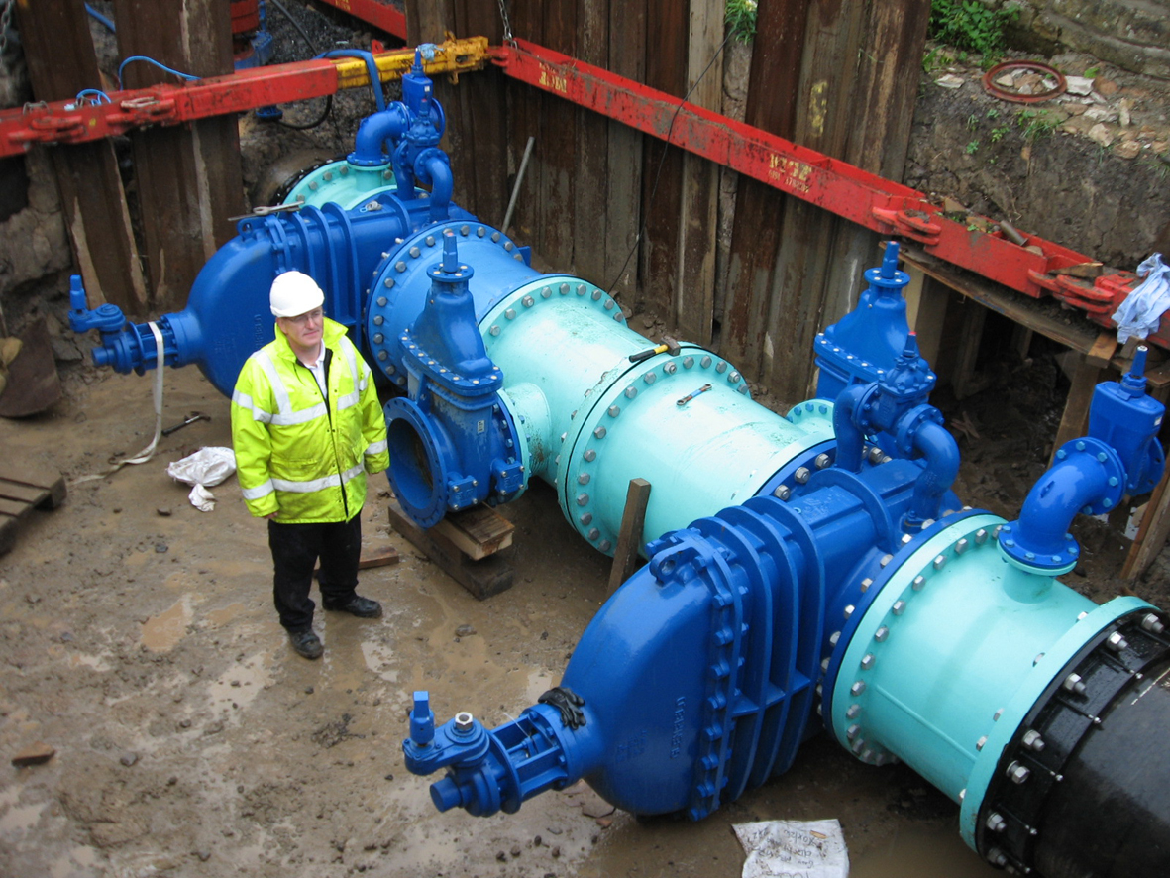
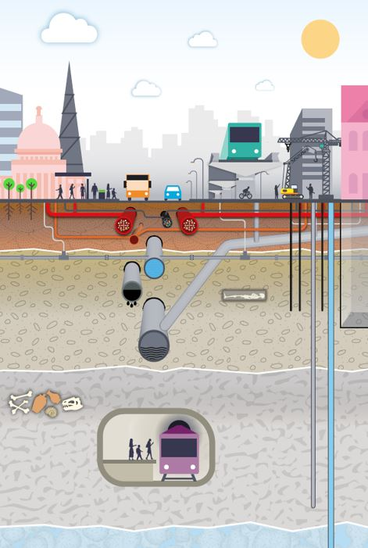
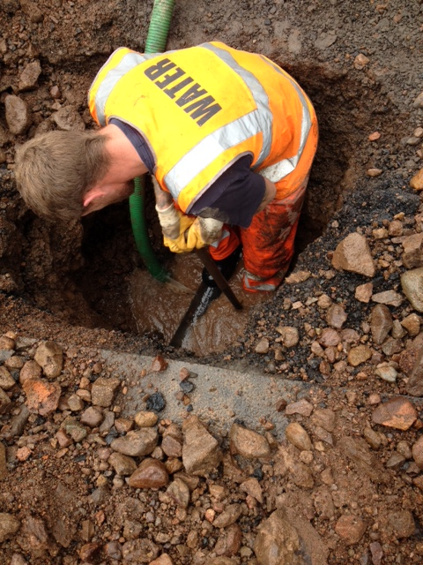
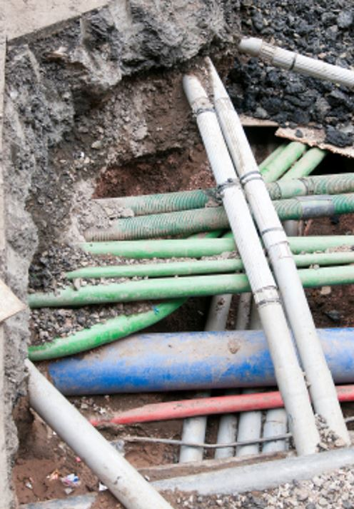
30,000 Km Sewers
25,000 Km Water Mains
Notes:
We deliver these services through a network of 30,00km of sewers and 25,000Km of water mains.
These networks are made up of lengths of pipe, made of different materials (plastic, cast iron, even concrete) and of different diameters ranging from about 25mm to a couple of meters.

Slide 5
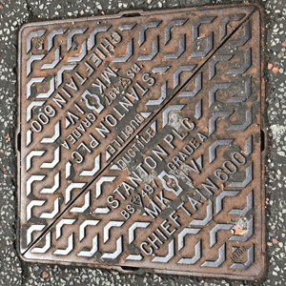
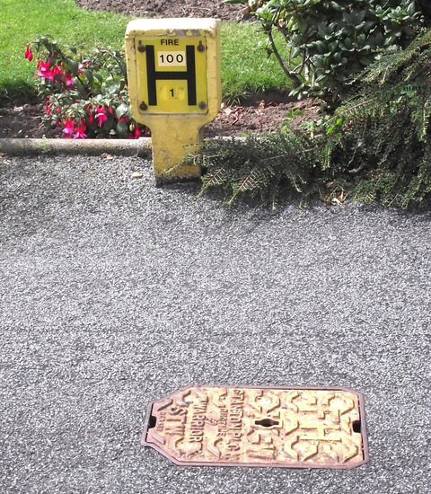
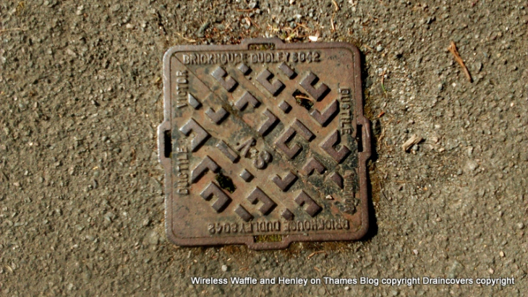
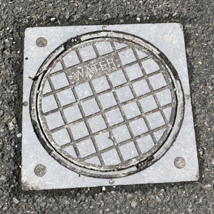
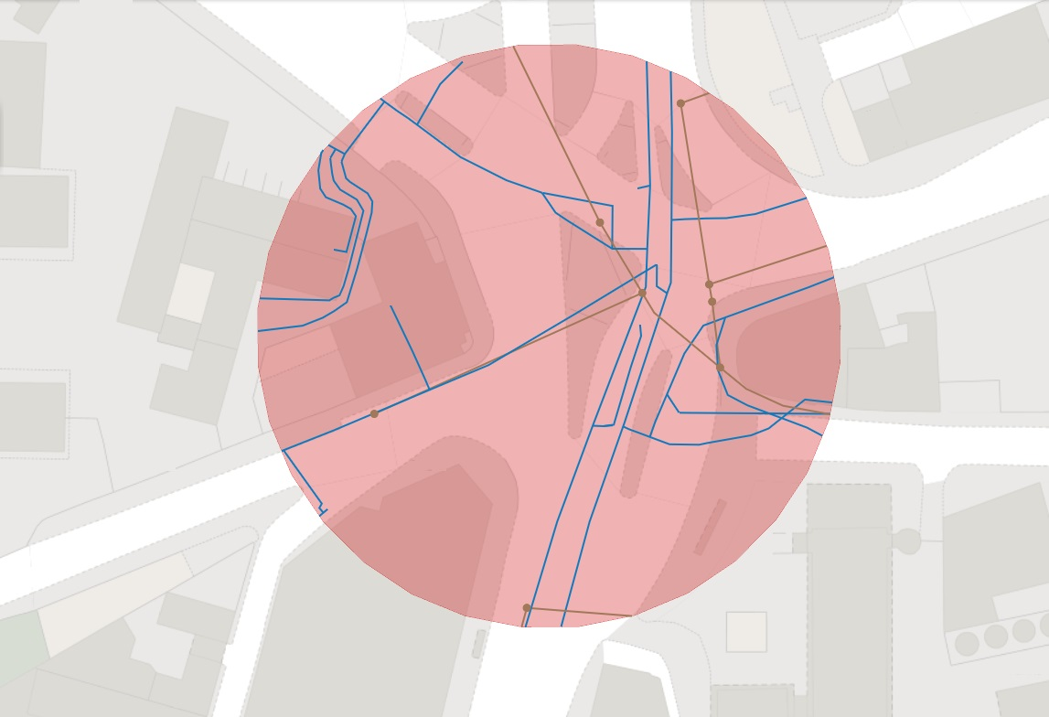
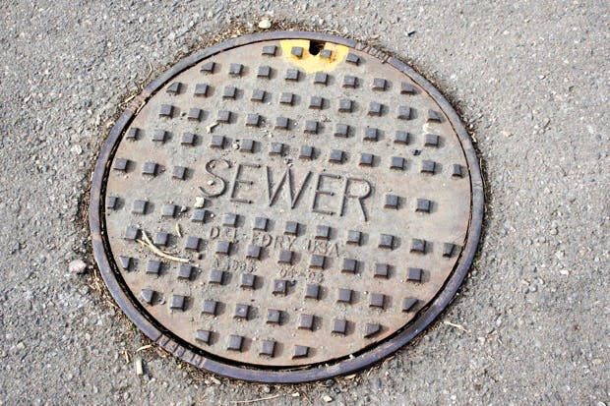
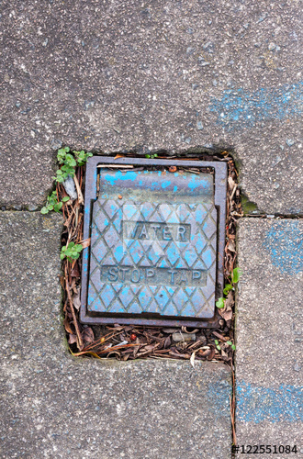
2D
Notes:
They are beneath our feet almost everywhere and you can see the evidence of them if you look around when you’re in the street. Take a look around you when you’re next out in the street. Manholes, larger to access the sewer network and Fire Hydrants, valves and cocks used to control the flow on the pressurised water network.
Knowing where those assets are is crucial to keeping the water flowing and we have pretty good 2 dimensional maps of them. The more accurately we know things like the depth of those mains and sewers, the more efficient we can be in our planning and this translates into better service for our customers, particularly response times. But we, in common with pretty well every utility company, do not have much of a record of the depth of these mains and sewers, particularly on the water network.

Slide 6
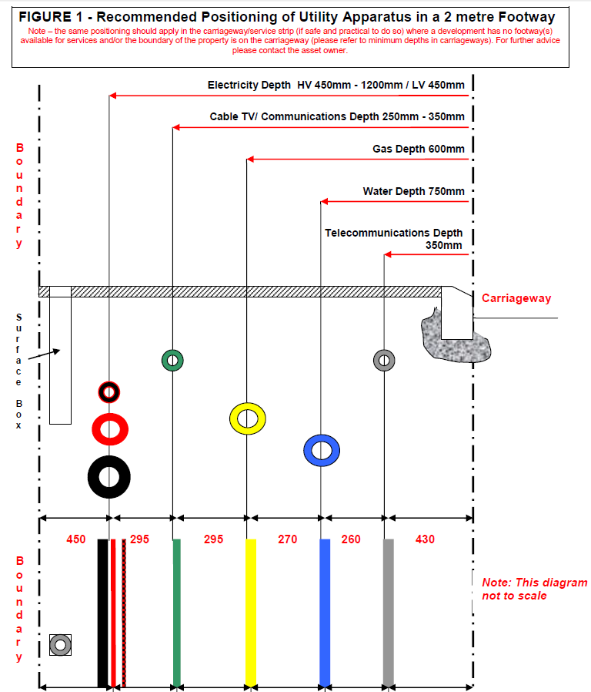
Guidelines from NJUG
Notes:
In the last 30 years or so, bodies like NJUG (National Joint Utilities Group) which state where in the pavement and how deep each utilities should bury its assets.

Slide 7
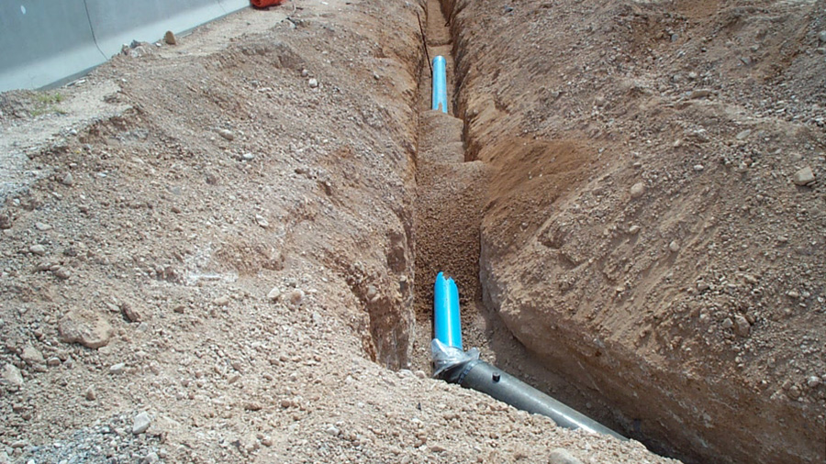

0.75m –1.2m
Pipes > 30 yrs old
Nominal Depth is rarely measured and recorded
Notes:
But of course many of mains and sewers were buried before these guidelines came into force
And depth is rarely measured.

Slide 8
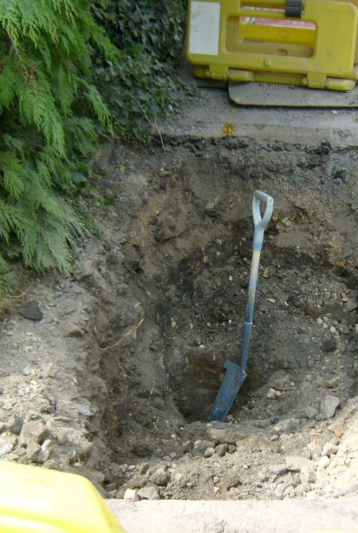
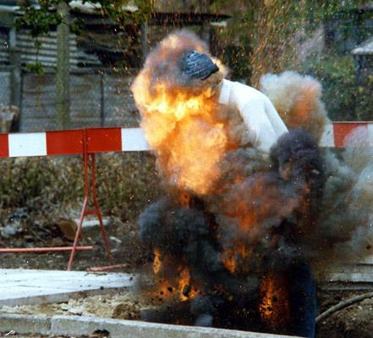

Why is depth important?
Finding assets quickly
Dry holes
Utility strike avoidance
Improved planning
“It is estimated that the cost to the UK’s economy of accidental strikes on underground pipes and cables is £1.2bn a year”
Notes:
So why is knowing the expected depth so important?
Locating assets quickly, it reputedly costs £500 to send a crew out to dig a hole. Anec dote about dry holes and finding service in the first hole to be dug, but a bit deeper
Avoidance of utility strikes. A utility strike is where one utility strikes and damages the services of another, often because services were shallower than expected. This can injure or even kill workers and it can also disrupt service to customers
The better we know depth, the more precisely we can plan the expected duration of a job, avoiding fines for overstaying our permit because services were deeper than expected

Slide 9
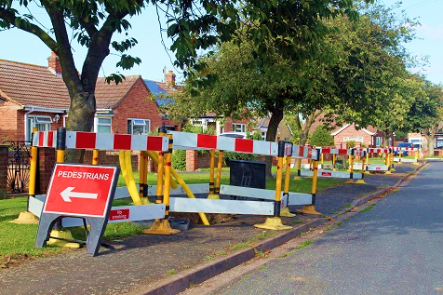
The challenge
Come up with a tool / algorithm
Based on what we do know
Tell us the most likely depth of every main and sewer
So we can add to our map
Notes:
The challenge is this:
To come up with an algorithm that allows us to accurately predict how deep any given main or sewer is likely to be
Based on the age, material, diameter, gradient, position in the road, pavement or verge, based on whether it is urban or rural
And using known depths where we have them

Slide 10
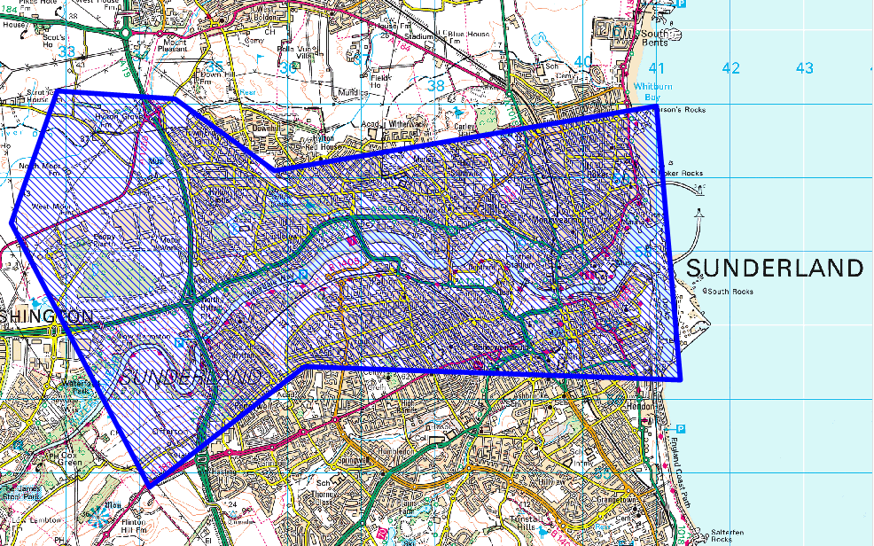
Data available…
Background mapping
30 Sq Km of NWG network asset information
Position
Depth where known / measured
Pipe material
Pipe diameter
Date pipe laid
Nominal gradients
Notes:
We’ve selected a pice eof our network with really varied terrain:

Slide 11
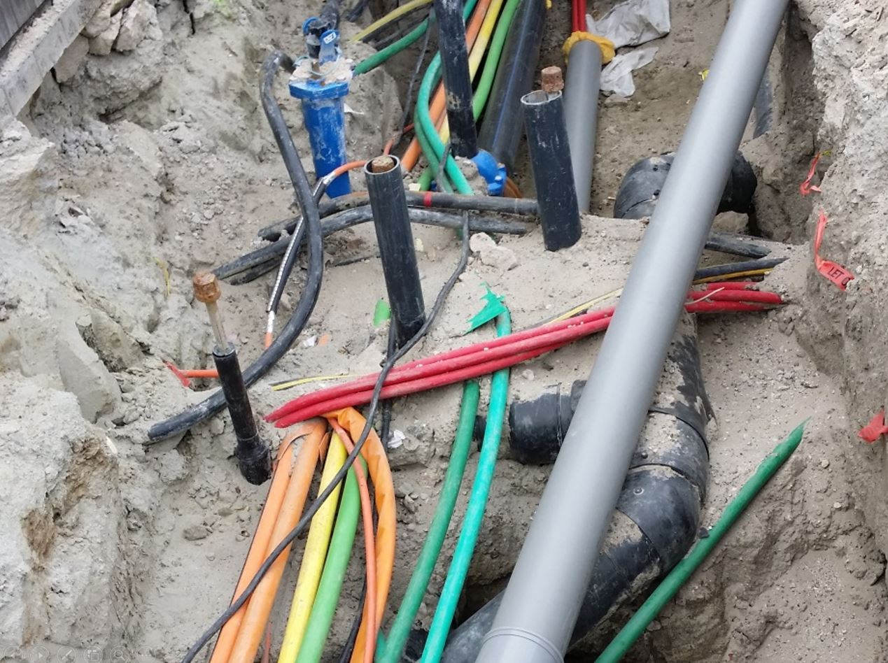
Good Luck !
Support
Clive Surman-Wells
Clive.surman-wells@nwl.co.uk
07816 317998
Mat Marshall
Phone support available Saturday and Sunday

